Slide 1
INVESTMENT ASSIGNMENT
SUBMISSION
Name: Supriya Raman

Slide 2

Spark Funds have a problem statement !!!
Spark Funds wants to make investments in a few companies. The CEO of Spark Funds wants to understand the global trends in investments so that she can take the investment decisions effectively.
Business objective: The objective is to identify the best sectors, countries, and a suitable investment type for making investments. The overall strategy is to invest where others are investing, implying that the 'best' sectors and countries are the ones 'where most investors are investing‘
Following are some of the considerations –
It wants to invest between 5 to 15 million USD per round of investment.
It wants to invest only in English-speaking countries because of the ease of communication with the companies it would invest in
Spark Funds wants to understand the trend and invest where most other investors are investing.

Slide 3


Let’s Set the Goal
Business Objective has been divided into following sub-goals:-
Investment type analysis: Compare the typical investment amounts in each of the below funding types to choose the type one which best suites for Spark Funds’ strategy-
venture
seed
angel
private equity
Country analysis: Identify the top three English-speaking countries which have been the most heavily invested in the past.
Sector analysis: Understanding the distribution of investments across the eight main sectors. Listed below
  Automotive & Sports
  Cleantech / Semiconductors
  Entertainment
  Health
  Manufacturing
  News, Search and Messaging
  Others
  Social, Finance, Analytics, Advertising

Slide 4
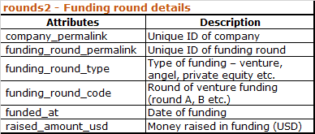
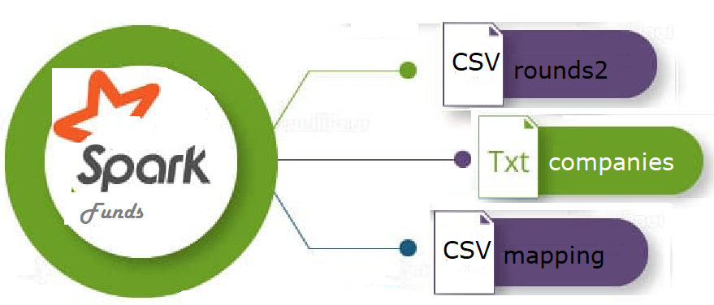
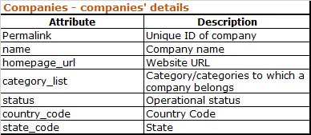

Data Files
Data collected from real investment data from crunchbase.com

Slide 5

DATA EXPLORATION and PREPARATION
Companies Table –
List of companies present in companies.txt are loaded into dataframe named “df_companies"
Data is read using “palmos” encoding and Tab as a separator
Column “permalink” is converted to lower case to enable merge of dataframes.
rounds2 Table –
This table contains funding rounds details present in rounds2.csv are loaded into dataframe named “df_rounds2”
Data is read using “palmos” encoding
Column “company_permalink” is converted to lower case and the column name is renamed to “permalink” – this is done to enable merge of dataframes.
Both the above dataframes are merged to form “master_frame” dataframe to facilitate all analysis.

Slide 6

FUNDING TYPE Analysis
Sparks Funds want to invest between 5 to 15 million USD per round of investment
The objective of this analysis is to choose one suitable funding type from among below four funding types based on the most representative investment amount –
venture
angel
seed
private equity
“master_frame dataframe data was grouped by
“funding_round_type” field.
Mean of each funding type was calculated ignoring the null values.
“Venture” was identified as the most suitable investment type.

Slide 7
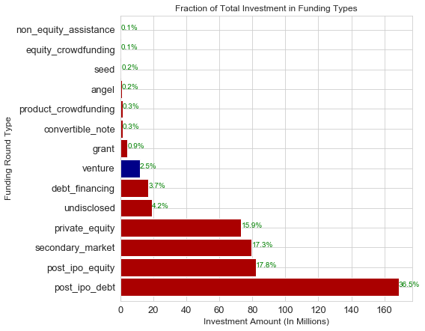
FUNDING TYPE Analysis - RESULT

Slide 8

COUNTRY Analysis
The analysis was done to identify the top three English-speaking countries which have received the highest total funding (across ALL sectors for the “venture” investment type).
Filter was applied on “master_frame” dataframe to extract required data as following:-
  country code is not null
  Raised amount USD (Investment amount) is not null
  Funding type is venture
  Columns “funding_round_type","raised_amount_usd” and "country_code” were extracted for analysis.
“top9” dataframe was created with sum of funding amount grouped by Country code.
From the top9 countries listed in the dataframe, top three English speaking countries were selected.

Slide 9
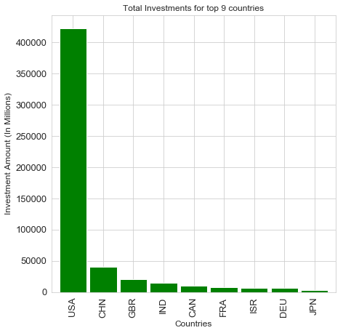
COUNTRY Analysis - RESULT

Slide 10

SECTOR Analysis
The analysis was done to identify the sectors in which Spark Funds would be recommended to invest in.
“primary sector” is extracted using business rule as first string before the
vertical bar in “category_list” column and was stored in “master_frame.
Sector classification file mapping.csv was read using “palmos” encoding and was loaded into dataframe named “df_mapping“.
“category_list” column in df_mapping is found with spelling mistakes. Data was corrected to replace 0 with substring text as 'na'
Each “primary_sector” value in master_frame was mapped to “main sector” field value in “df_mapping” dataframe. Extracted new data was added in dataframe “final_list”.
Three dataframes D1, D2 and D3 were extracted from “final_list” for three top English speaking countries with funding type as “venture” only and investment amount in range of 5 to 15 millions (both inclusive)
Sum and count of investment grouped by eight main sectors was extracted and added as separate columns in D1, D2 and D3.

Slide 11
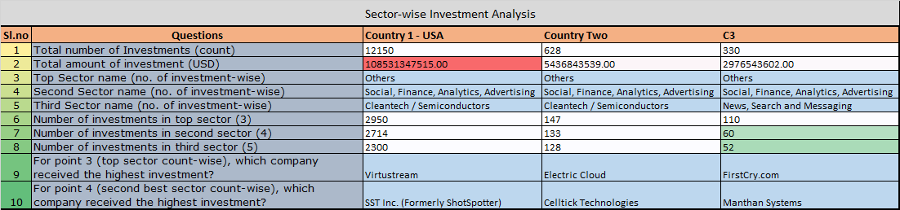
SECTOR WISE INVESTMENT ANALYSIS- Results
The detailed analysis helped to list the observations as below -

Slide 12
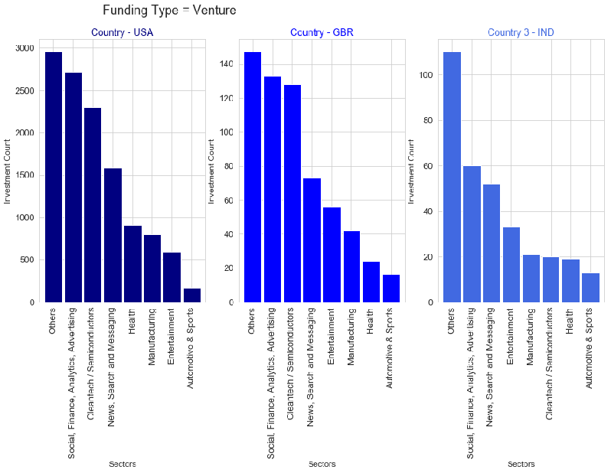
ANALYSIS SUMMARY

Slide 13


THANK
YOU

